Slide 1
Git Basic Commands

Slide 2

Basic Git commands
git init
git clone
git add
git rm
git status
git commit
git push
git pull
git checkout

Slide 3
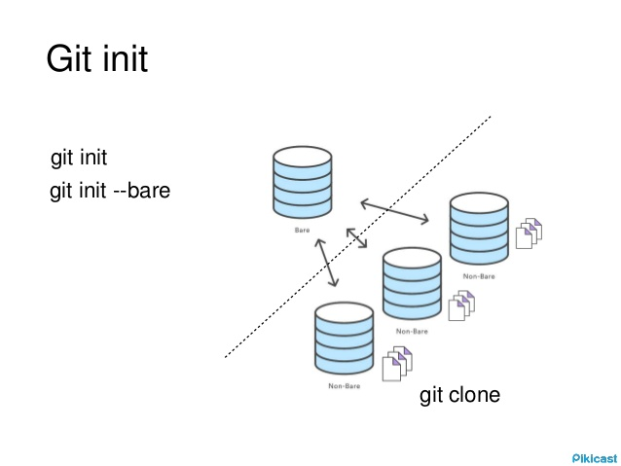
Git init: Create an empty Git repository or reinitialize an existing one.
Run git init
$ git init workbase
(This will create a workbase directory and initialized this with .git directory.)
Options
-q : --quiet :
Only print error and warning messages; all other output will be suppressed.
--bare :
Create a bare repository.

Slide 4
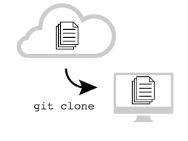
Git clone: Copies an existing Git repository.
Run git clone
$ git clone <repo>
(This will make a copy of remote directory into your local machine)
Options
-l : --local :
Repository to clone from is on a local machine.
-o <name> : --origin <name> :
Instead of using the remote name origin to keep track of the upstream repository, use <name>.

Slide 5
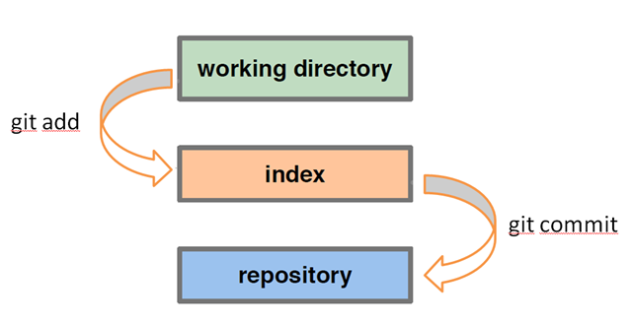
Git add: Add file contents to the index.
Run git add
$ git add <filename or wildcard>
(This will add your files to the index or staging area in git.)
Options
-n : --dry-run :
Don’t actually add the file(s), just show if they exist and/or will be ignored.
--no-all : --ignore-removal :
Add new files to index but ignore files that have been removed from the working tree.

Slide 6
Git rm: Remove file contents to the index.
Run git rm
$ git rm <filename or wildcard>
(This will remove your files from the index or staging area in git.)
Options
-n : --dry-run :
Don’t actually remove any file(s), just show if they exist and/or will be ignored.
-r :
Allow recursive removal when a leading directory name is given.
--cached
Use this option to unstage and remove paths only from the index. Working tree files, whether modified or not, will be left alone.
git rm

Slide 7
Git commit: Record changes to the repository.
Run git commit
$ git commit -m “<message>”
(This will remove your files from the index or staging area in git.)
Options
-a : --all :
Tell the command to automatically stage files that have been modified and deleted, but new files you have not told Git about are not affected.
-n : --dry-run :
Don’t actually commit any file(s), just show if they exist and/or will be ignored.
-C <commit> : --reuse-message=<commit> :
Take an existing commit object, and reuse the log message and the authorship information (including the timestamp) when creating the commit.

Slide 8
Git push: Update remote refs along with associated objects.
Run git push
$ git push <remote name> <branch>
(This will ship your files from the local repo to remote repo.)
$ git push origin HEAD:master
(This will ship your files from current local branch to the remote master branch.)
Options
-n : --dry-run :
Do everything except actually send the updates.
--delete :
All listed refs are deleted from the remote repository. This is the same as prefixing all refs with a colon.
Remote Repo
git push
git push
Local Repo
Local Repo

Slide 9
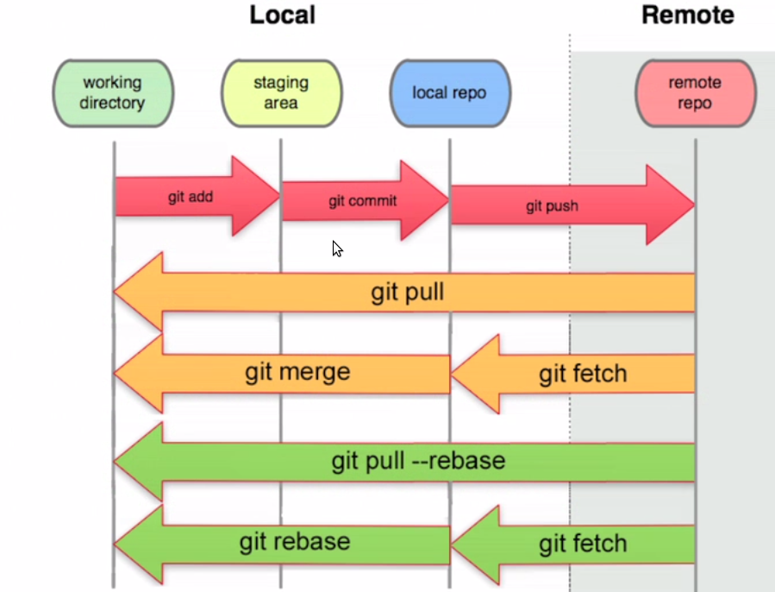
Git pull: Fetch from and integrate with another repository or a local branch.
Run git pull
$ git pull <remote name> <branch>
(This will ship all the changes from remote to local repo and merge too.)
Options
--commit :
Perform the merge and commit the result. This option can be used to override --no-commit.
--ff :
When the merge resolves as a fast-forward, only update the branch pointer, without creating a merge commit. This is the default behavior.

Slide 10
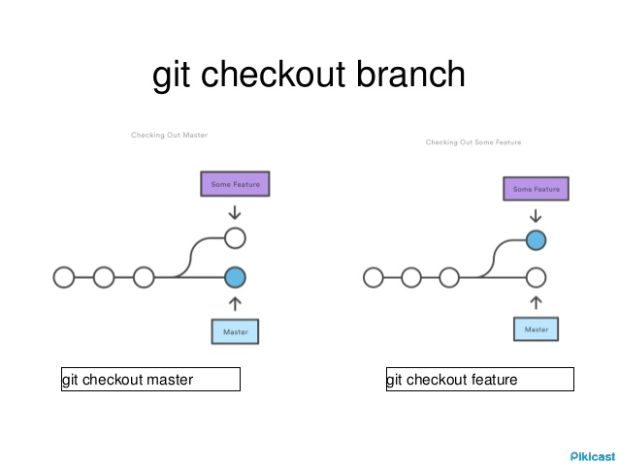
Git checkout: Switch branches or restore working tree files.
Run git checkout
$ git checkout <branch name>
(This will switch into a branch.)
$ git checkout -b <branch name>
(This will first create and then switch into that branch.)
Options
-f : --force :
When switching branches, proceed even if the index or the working tree differs from HEAD.
-B <new_branch>
Creates the branch <new_branch> and start it at <start_point>; if it already exists, then reset it to <start_point>.

Slide 11
